Slide 1
Notes:
Introduce:
Who you are
Grade
Position on the team
How you joined the team
Why that business

Slide 2
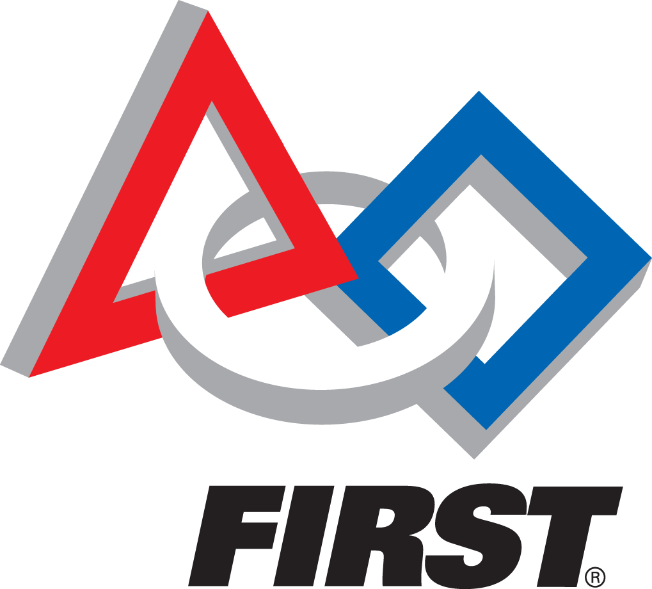
FIRST stands for:
For
Inspiration and
Recognition of
Science and
Technology
Notes:
What is FIRST?
FIRST is all about “Making STEM fun”
Young people should look up to engineers just like athletes and stars
Dean Kamen and Woody Flowers
Sports model
Four levels:
FRC
FTC
FLL
Jr. FLL

Slide 3
The Mission of FIRST:
Inspiring students to be STEM leaders
Learning real-world skills
Building
Self Confidence
Leadership
Teamwork
Notes:
What do students get out of STEM?
Find their passion
Learn real world skills like CAD, building, wiring, programing
If you work on another part of the team, show that it’s more than robots
Tell how robotics builds (don’t just list them)
Self confidence
Leadership
Teamwork

Slide 4
Skunk Works at a Glance:
41 Students
20 Mentors
2 Robots
Year Round
Operation
FTC Team
Notes:
What is Skunkworks?
Give a story about the team history (where we got our name, what it means)
1 of over 150 team in Washington state
Been a team for 10 years

Slide 5
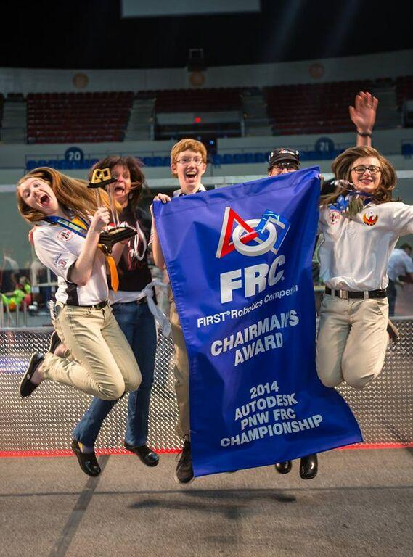
2016 Competition Season
Winning Alliance at 3 Districts & the PNW Regional:
Auburn Mountainview District Event
Central Washington District Event
Philomath District Event
Portland Regional Event
Won District Chairman’s Award at Central
Notes:
How we did last year?
Won all 3 district events we went to
Chairman’s award at district and district championship level
Competed for Chairman’s at Worlds
Semi-finals at worlds
Winner from our field won Einstien’s

Slide 6
Skunk Works competes with teams on a local, regional, and international level.
District Events
Regional Events
National Events
Auburn
Mountainview
PNW District Championship
Houston World Championships
Central
Washington
Philomath
Oregon
Notes:
Talk about the District model
FIRST is a sports model

Slide 7
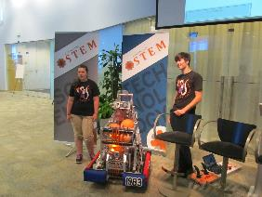
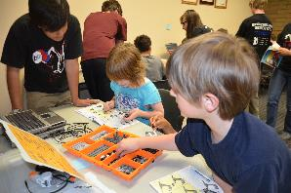
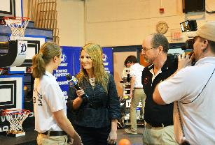
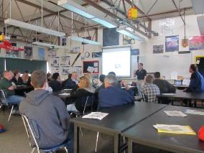
Year-Round Outreach Efforts
Community & Industry Events
Summer Workshops
Business Outreach/ Engagement
FRC Workshops
Notes:
Robotics is about more than just building robots:
What is community outreach?
What is business outreach?
What is our VEX team?
What do we do in the pre-season?
What do we do in the post-season?

Slide 8
Sponsors Support is used in Many Ways
Robot Construction
Practice Field
Travel Expenses
Outreach Opportunities
Notes:
Talk about robotics being very expensive:
Building 2 robots
Running a rookie team
Practice field
Hotels
Airline flights
Food
Materials
Shop
As you can see, robotics is very expensive and we can’t do what we do without support of our sponsors. Sponsors are vital to:
Robot Construction (talk more)
Practice field (talk more)
Travel Expenses (talk more)
Outreach Opportunties (talk more)

Slide 9
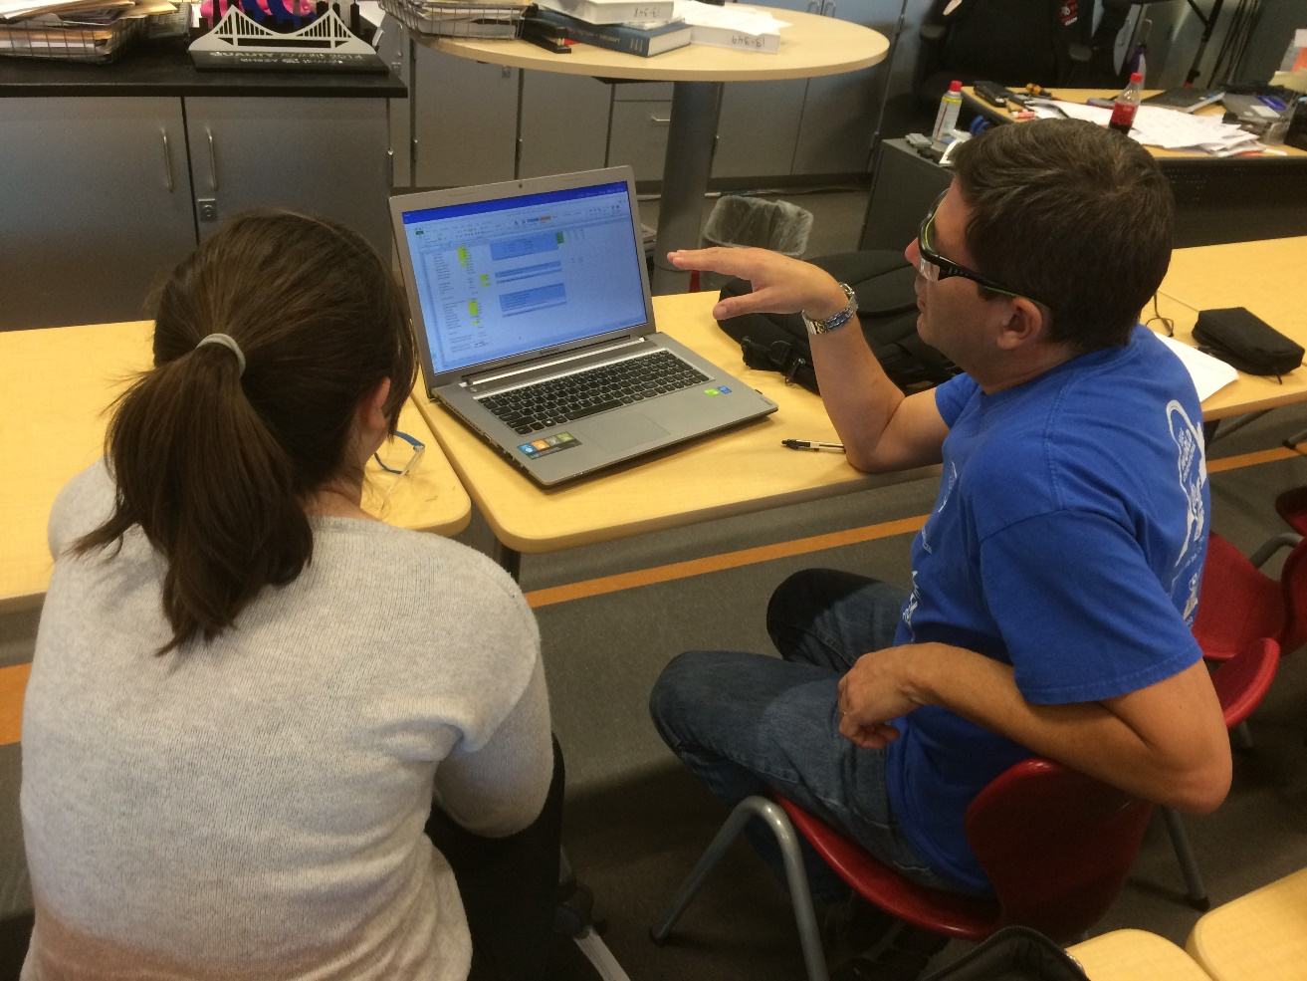
Getting Involved
Mentoring
Monetary Support
In-Kind Services
Internships
Notes:
Here’s how sponsors help us: (EXPLAIN THESE, DON’T JUST LIST THEM)
Mentoring
Monetary support
In-kind services
internships

Slide 10
Notes:
Give them the documents
Say thank you

